Slide 1
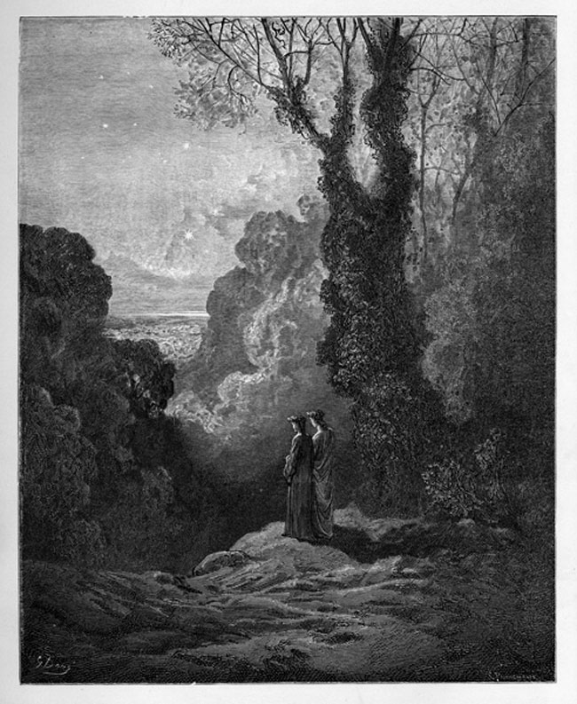
Purgatorio: I-II, IX, XVI
23 March 2020

Slide 2
PATTERNS: From the end of Inferno
Apostrophes
“How then I became frozen and feeble, do not ask, / reader, for I do not write it, and all speech would be / insufficient. I did not die and I did not remain alive: think / now for yourself, if you have wit at all, what I / became, deprived of both.” XXXIV 22-24
Tropes of incommunicability
“How then I became frozen and feeble, do not ask, / reader, for I do not write it, and all speech would be / insufficient.” XXXIV 22-24
Body metaphors
Mouths, chewing, devouring
The center of the universe is at Lucifer’s anus, Dante thus ‘exits’ through the anus in a body metaphor that to a large degree progresses from the head down through the body.
City metaphors
The giants are like the towers of medieval towns where clans built their own towers for warfare and espionage
This is called ‘Dis’ again XXXIV 20
Dante names and criticizes many Tuscan cities in these cantos.
Montereggione, above all Pisa and Genoa
The bridging of the Classical and the Biblical
We see the giants come from both traditions, Nimrod from the Old Testament, Ephialtes is the son of Neptune, Antaeus is from Pharsalia
We see that the three greatest sinners are a bridge. Judas, the worst, was a traitor to Jesus. Brutus and Cassius to Julius Caesar

Slide 3
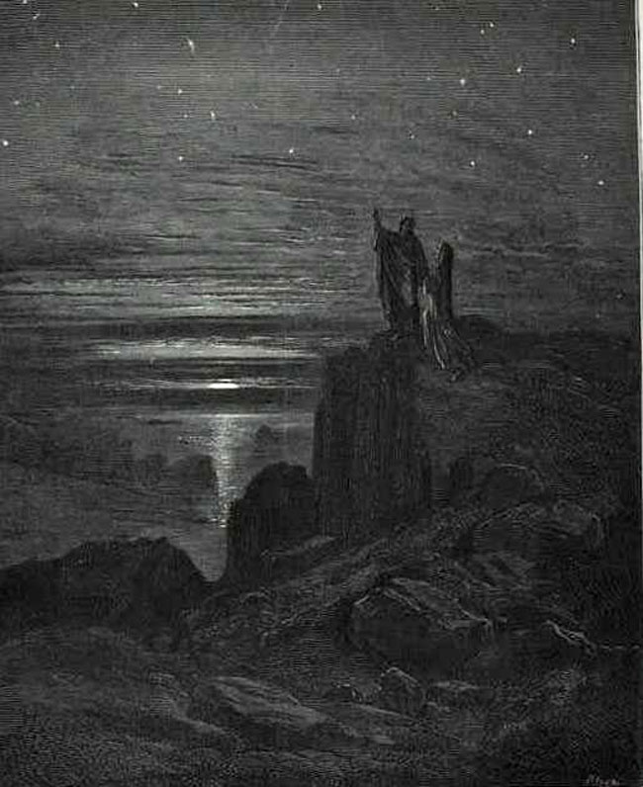
“E quindi uscimmo a riveder le stelle.”

Slide 4
Purgation in the Afterlife
Plato and Pythagoras believed in reincarnation with periods of 1,000 years as punishment in intervals between lives
Virgel’s Aeneid circulated some of these ancient doctrines during the years that the literature itself was lost to the West
The Bible does not specifically mention a Purgatory, but there are numerous implications of purgation after death
The term was only coined in 1170, afterwards it started being more fully conceived of
One passage in Matthew uses a monetary metaphor, which led to the custom of ‘indulgences’, which led to a practice of ‘accountancy’ of sins and allowed believers to literally ‘pay back’ their sins through ‘good deeds'
INDULGENCE: "a way to reduce the amount of punishment one has to undergo for sins". It may reduce the "temporal punishment for sin" after death in the state or process of purification called Purgatory.
Indulgences were rife with abuse by the late Middle Ages, especially as one ‘good deed’ was considered to be ‘donation to the Church’, which became in a sense a way to bribe one’s way to Heaven
One of the central tenets of the Protestant Reformation was the rejection of the doctrine of Purgatory (and thus the efficacy of indulgences), specifically due to the ‘selling of indulgences’ which had become particularly problematic in the late Middle Ages
Pope Boniface VIII declared 1300 a Jubilee year with ‘plenary [absolute] indulgence’ for any pilgrims who came to Rome and visited the basilicas of Saint Peter and Paul a specified number of times

Slide 5
Dante’s Unique Purgatory 1
Dante’s treatment of it is profoundly different from orthodox Christian views
Ante-Purgatory: is unique to his depiction
Structure:
With the idea of ‘accountancy’ coupled with the emergence of mechanically measured time, Purgatory came to be increasingly thought of as a strict “time is restored for time” structure
Dante’s Purgatory represents a “marked advance in rendering the concept both concrete and systematic” (Durling, Purgatorio, 6)
Who can be saved?
Until Aristotle was rediscovered, Augustine’s pessimistic conception of man as redeemable (see: virtuous) only through knowledge of Christ was dominant. Dante’s view is one of the most optimistic of the Middle Ages, meaning, that he sees man as inherently virtuous (non-Christians could live without sin as well as Christians)
This was largely due to Aristotle’s conception of “natural moral virtue and vice” which was reintroduced to the West in the 12th century
Aristotle:
“In the Aristotelian conception, vice is a tendency to act wrongly; virtue is a tendency, governed by reason and acquired by, and realized in, repeated action, to act rightly. […] Acting on the inclination is what consitutes sin” not the inclination itself. (Durling 8)
Implied is an inner war between IMPULSE and REASON that is fundamental to Dante’s conception of ‘learning to act morally‘.
This is fundamental to Dante’s conception: moral virtue is attainable through reason, not only through the knowledge of Christ. Thus, man need not rely on the Church to guide him, he may follow his own reason.
Reason for punishment:
In the Church’s view of Purgatory, the punishment is called ‘temporal punishment’ and is opposed to ‘eternal punishment’
In Dante’s view, Purgatory is a place of learning ‘moral discipline’, which implies that Purgatory is still a place attached to the temporal sphere, where all things are governed by change

Slide 6
Dante’s Unique Purgatory 1
Dante’s treatment of it is profoundly different from orthodox Christian views
Ante-Purgatory: is unique to his depiction
Structure:
With the idea of ‘accountancy’ couple with the emergence of mechanically measure time, Purgatory came to be increasingly thought of as a strict “time is restored for time” structure
Dante’s Purgatory represents a “marked advance in rendering the concept both concrete and systematic” (Durling, Purgatorio, 6)
Who can be saved?
Until Aristotle was rediscovered, Augustine’s pessimistic conception of man as redeemable (see: virtuous) only through knowledge of Christ was dominant. Dante’s view is one of the most optimistic of the Middle Ages, meaning, that he sees man as inherently virtuous (non-Christians could live without sin as well as Christians)
This was largely due to Aristotle’s conception of “natural moral virtue and vice” which was reintroduced to the West in the 12th century
Aristotle:
“In the Aristotelian conception, vice is a tendency to act wrongly; virtue is a tendency, governed by reason and acquired by, and realize din, repeated action, to act rightly. […] Acting on the inclination is what consitutes sin” not the inclination itself. (Durling 8)
Implied is an inner war between IMPULSE and REASON, that is fundamental to Dante’s conception of learning to act morally.
This is fundamental to Dante’s conception: moral virtue is attainable through reason, not only through the knowledge of Christ. Thus, man need not rely on the Church to guide him, he may follow his own reason.
Reason for punishment:
In the Church’s view of Purgatory, the punishment is called ‘temporal punishment’ and is opposed to ‘eternal punishment’
In Dante’s view, Purgatory is a place of learning ‘moral discipline’, which implies that Purgatory is still a place attached to the temporal sphere, where all things are governed by change

Slide 7
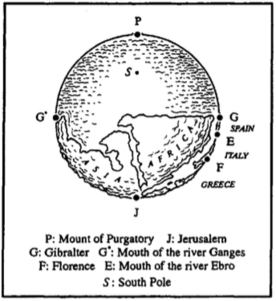
Dante’s Unique Purgatory
Much was undecided about doctrinal Purgatory. For example, its location and structure.
The Location
It was antipodal to Jerusalem
Located on the ‘watery’ southern Hemisphere, which Dante considered Earth’s better half (because the Arisotelian belief in ‘absolute up’ made the South the direction toward god)
It is halfway between the Earth and the moon
Because it is sub-lunar it is part of the temporal and mutable Earth

Slide 8
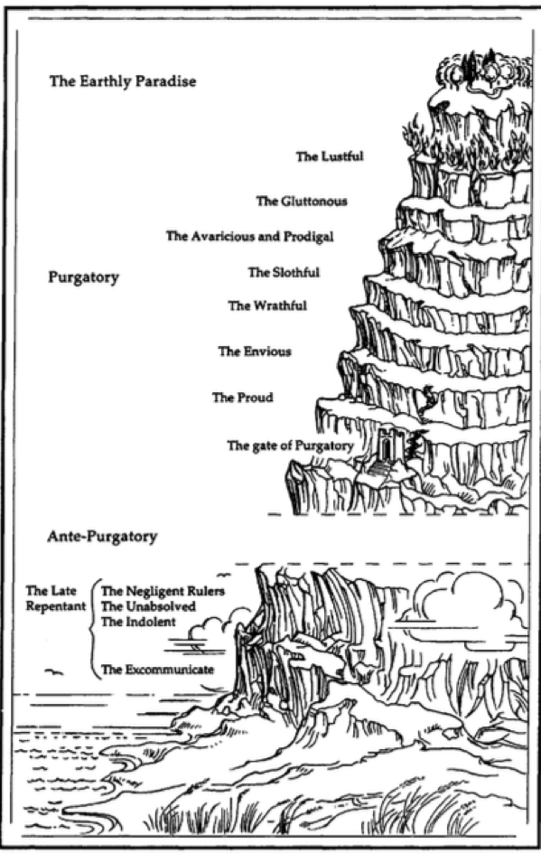
Dante’s Unique Purgatory
The Structure
Ante-Purgatory
The Gate
Purgatory Proper
Seven Terraces (corresponding to 7 Deadly Sins or Vices)
Each terrace has examples of the sin and its opposite virtue
Each terrace has its contrapasso temporal punishment
Garden of Eden (earthly paradise)

Slide 9
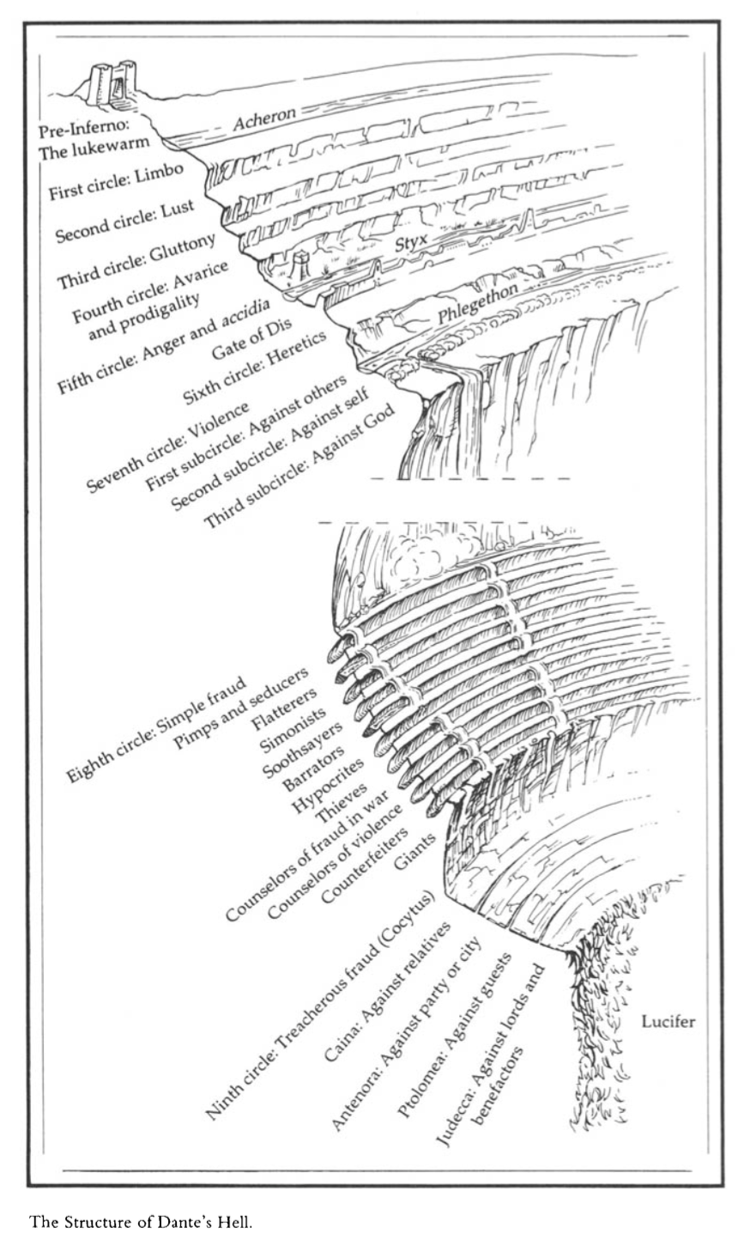
DISCUSSION: THE STRUCTURE
How would you compare the structures of Inferno and Purgatorio?

Slide 10
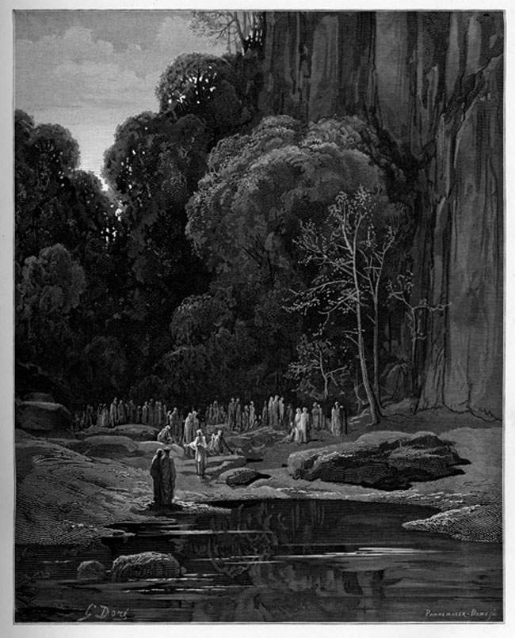
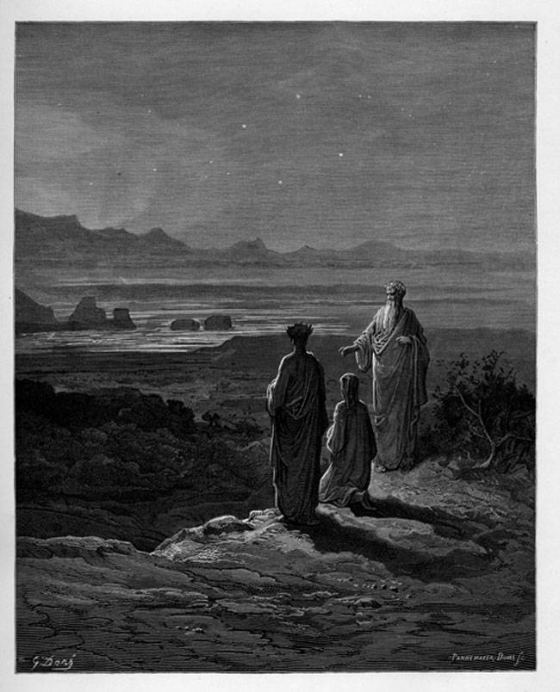
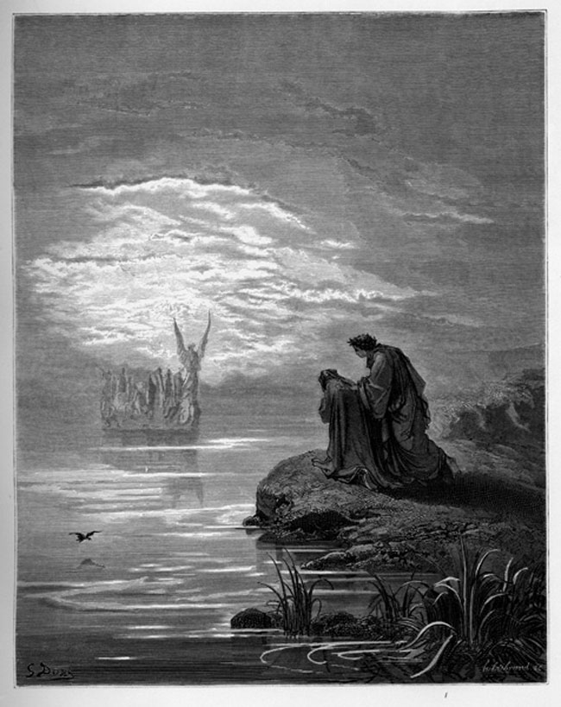
The Pilgrim’s Journey Cantos 1-16
Cantos 1-8
Ante-Purgatorio
Cato
The excommunicated, the negligent, the violently killed and late repentant

Slide 11
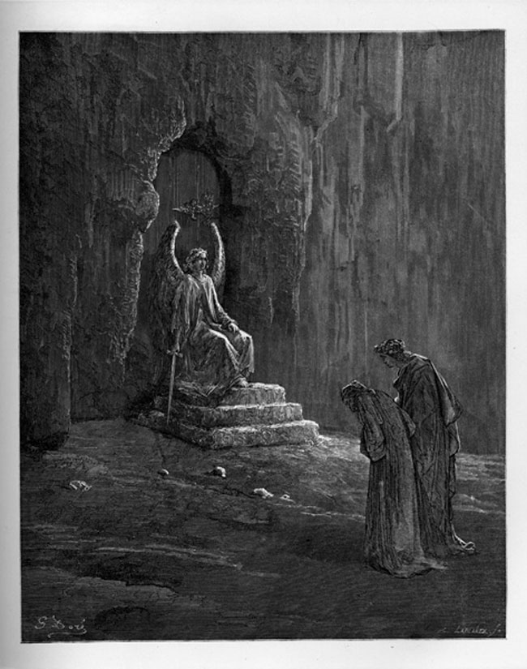
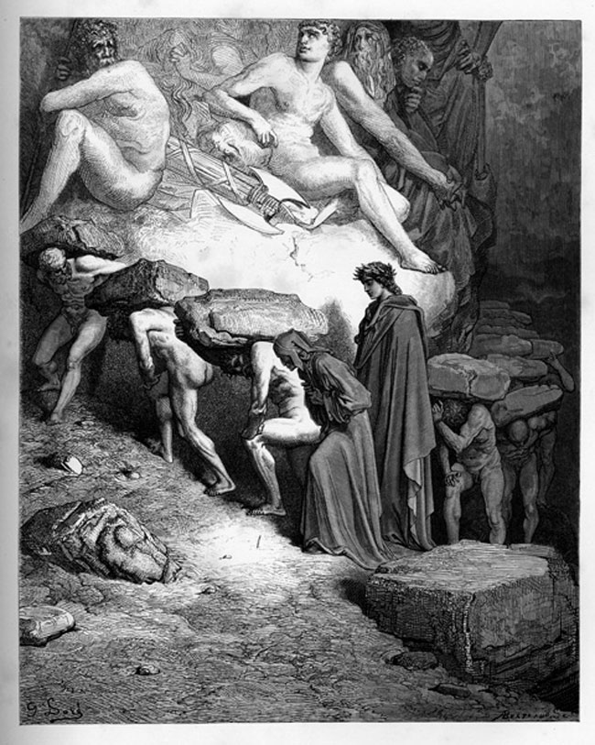
The Pilgrim’s Journey Cantos 1-16
Cantos 9-12
Canto 9:
Dante gets carried to the gate
The Gate to Purgatory
Cantos 10-12: First Terrace
Pride
Carved examples of humility
Souls carry heavy stones
Angel erases a P

Slide 12
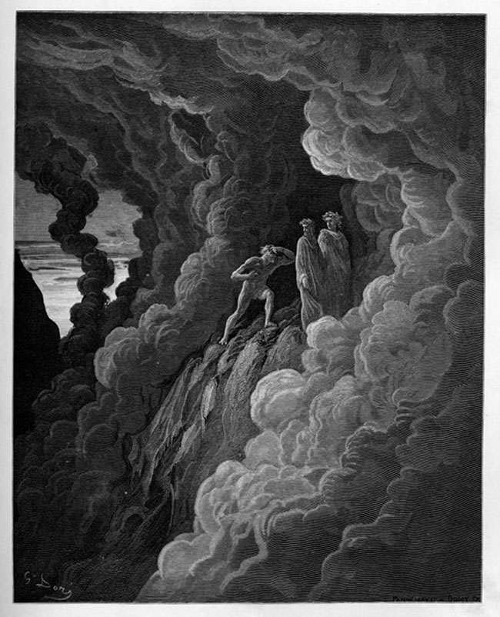
The Pilgrim’s Journey Cantos 1-16
Cantos 13-14: Second Terrace
Envy
Carved examples of compassion
Souls’ eyes are sown shut
Angel erases a P
Canto 15: Arrival at Third Terrace
Anger / Wrath
Carved examples of forbearance
Souls’ wander through cloud of smoke

Slide 13
Purgatorio I: ll. 1-10
“To run through better waters the little ship of
My wit now hoists it sails, leaving behind it a sea
So cruel,
And I will sing of that second realm where the
human spirit purges itself and becomes worthy to
Ascend to Heaven.
But here let dead poetry rise up again, O holy
Muses, since I am yours, and here let Calliope arise
Somewhat,
Accompanying my song.”

Slide 14
Discussion:
Canto 1, ll. 40-69
What is happening in this section of Canto 1? What is its larger function?
What do you notice that we have seen before and/or that is new?
Canto 1, ll. 70-98
What is happening in this section of Canto 1? What is its larger function?
What do you notice that we have seen before and/or that is new?

Slide 15
Discussion:
“Reader, you see how I am elevating my
Matter, and therefore do not marvel if with more
Art I bolster it.”
Canto 9
How does the pilgrim arrive at the Gates of Purgatory?
How is the gate described? How is it opened?
Compare the scene of the pilgrim’s arrival and the gate itself to descriptions in Inferno.

Slide 16
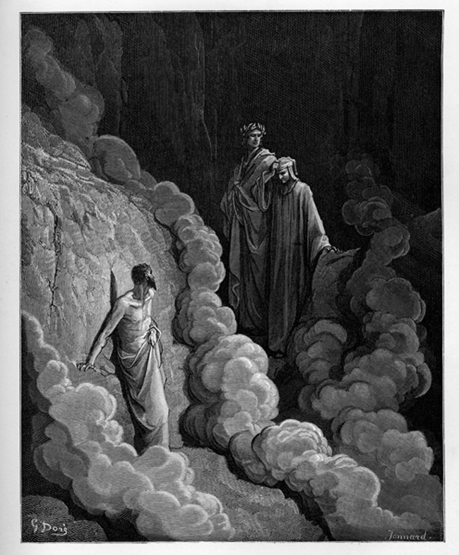
Canto XVI
This canto is very important. It develops many central themes.
Why does Dante-Author choose this canto, specifically, for such a crucial speech by Marco Lombardo?

Slide 17
Canto XVI (Canto L)
Discussion of:
The power of the stars (free will)
The causes of earthly disorder
The corruption of the papacy
The decadence of Dante’s time
The value of earlier examples of civic virtue
The role of rulers

Slide 18
Canto XVI (Canto L)
What is the contrapasso of the terrace? Why might this be symbolically important to the discussion in the canto?
Dante asks Marco Lombardo (ll. 58-62): “What is the cause of the malice on Earth? Is its origin in heaven or earth?”
How does Marco Lombardo respond?

Slide 19
Canto XVI (Canto L)
What is the contrapasso of the terrace? Why might this be symbolically important to the discussion in the canto?
Dante asks Marco Lombardo (ll. 58-62): “What is the cause of the malice on Earth? Is its origin in heaven or earth?”
How does Marco Lombardo respond?
“Brother, your world is blind, and surely you come from there.”

Slide 20
“Brother, your world is blind, and surely you come from there.”
If heaven were the cause of human action “free choice would be destroyed” (70)
“The heavens begin your motions […] a light is given you to know good and evil, and free will. [...] Thus if the present world has gone astray, in you is the cause.” (73-83)
“Of some lesser good [the soul] first tastes the flavor; there it is deceived and runs after it, if a guide or rein does not turn away its love.” (91-93)
“You can clearly see that bad government is the cause that has made the world wicked.” (103-104)
“It is necessary [...] to have a king who would discern the tower at least of the true city.” (94-96)
“The people [today] see their guide striking at the thing that they themselves are greedy for, [and thus] feed there and seek no further.” (100-102)
“Rome, which made the good world, used to have two suns that made visible the two paths, of the world and of God. One sun has extinguished the other, and the sword is joined to the shepherd’s staff, and it is ill for those two to be violently joined together.” (106-111)
The power of the stars
The causes of earthly disorder
The corruption of the papacy
The decadence of Dante’s time
The value of earlier examples of civic virtue
The role of rulers

